Slide 1
Measuring heart rate using a Raspberry Pi and AD8232 ECG Sensor
IOT FAM Group
Mahdiye Anbari
Atieh Talebiahooie
Udayanto Atmojo
Zahra Sabermahani
Project Description:
This project aims to design real-time heart rate monitoring using ECG sensor.
The ECS sensor measures the electrical signals from the heart, where the heart rate (BPM) value is then calculated.
The calculated heart rate is displayed live on an LCD display (128x64).
This system can be used to monitor an individual's health and assessing heart conditions.
Authors:
Results:
Successful BPM detection (example: 72 BPM)
Real-time display on OLED
signal is captured via electrodes with direct skin contact and good grounding
Equipment and Tools Used:
Microcontroller (MCU): Suitable microcontroller (e.g., ESP32 or Raspberry Pi Pico)
AD8232 ECG Sensor: For measuring the electrical signals produced from the heart beat
Heart Rate Monitor: Used to continuously track the heart rate during the measurement and display the calculated beats per minute (BPM).
OLED Display (LCD): To display the heart rate (BPM) in real-time
Pins and Connections:
GPIO 16 and GPIO 17 for I2C connection
ADC Pin for reading analog signals from the ECG sensor
How It Works:
ECG Signal Acquisition: The ECG sensor captures the electrical signals from the heart. The sensor converts these signals into a readable analog voltage signal.
Pulse Detection: The code uses an ADC pin to read the analog signal from the ECG sensor. The system detects when a heartbeat occurs based on a threshold value.
BPM Calculation: The program counts the number of heartbeats (pulses) detected during the measurement period (30 seconds in this case), and then calculates the heart rate in beats per minute (BPM).
Real-time Display: The calculated BPM is displayed in real-time on the OLED display. The display is updated continuously as new beats are detected.
Heart Rate Monitor: The system continuously monitors the heart rate, giving live feedback about the heart's condition. It can assess health or check for abnormal heart rate values.
Internet of Things Master’s, Spring 2025

Slide 2
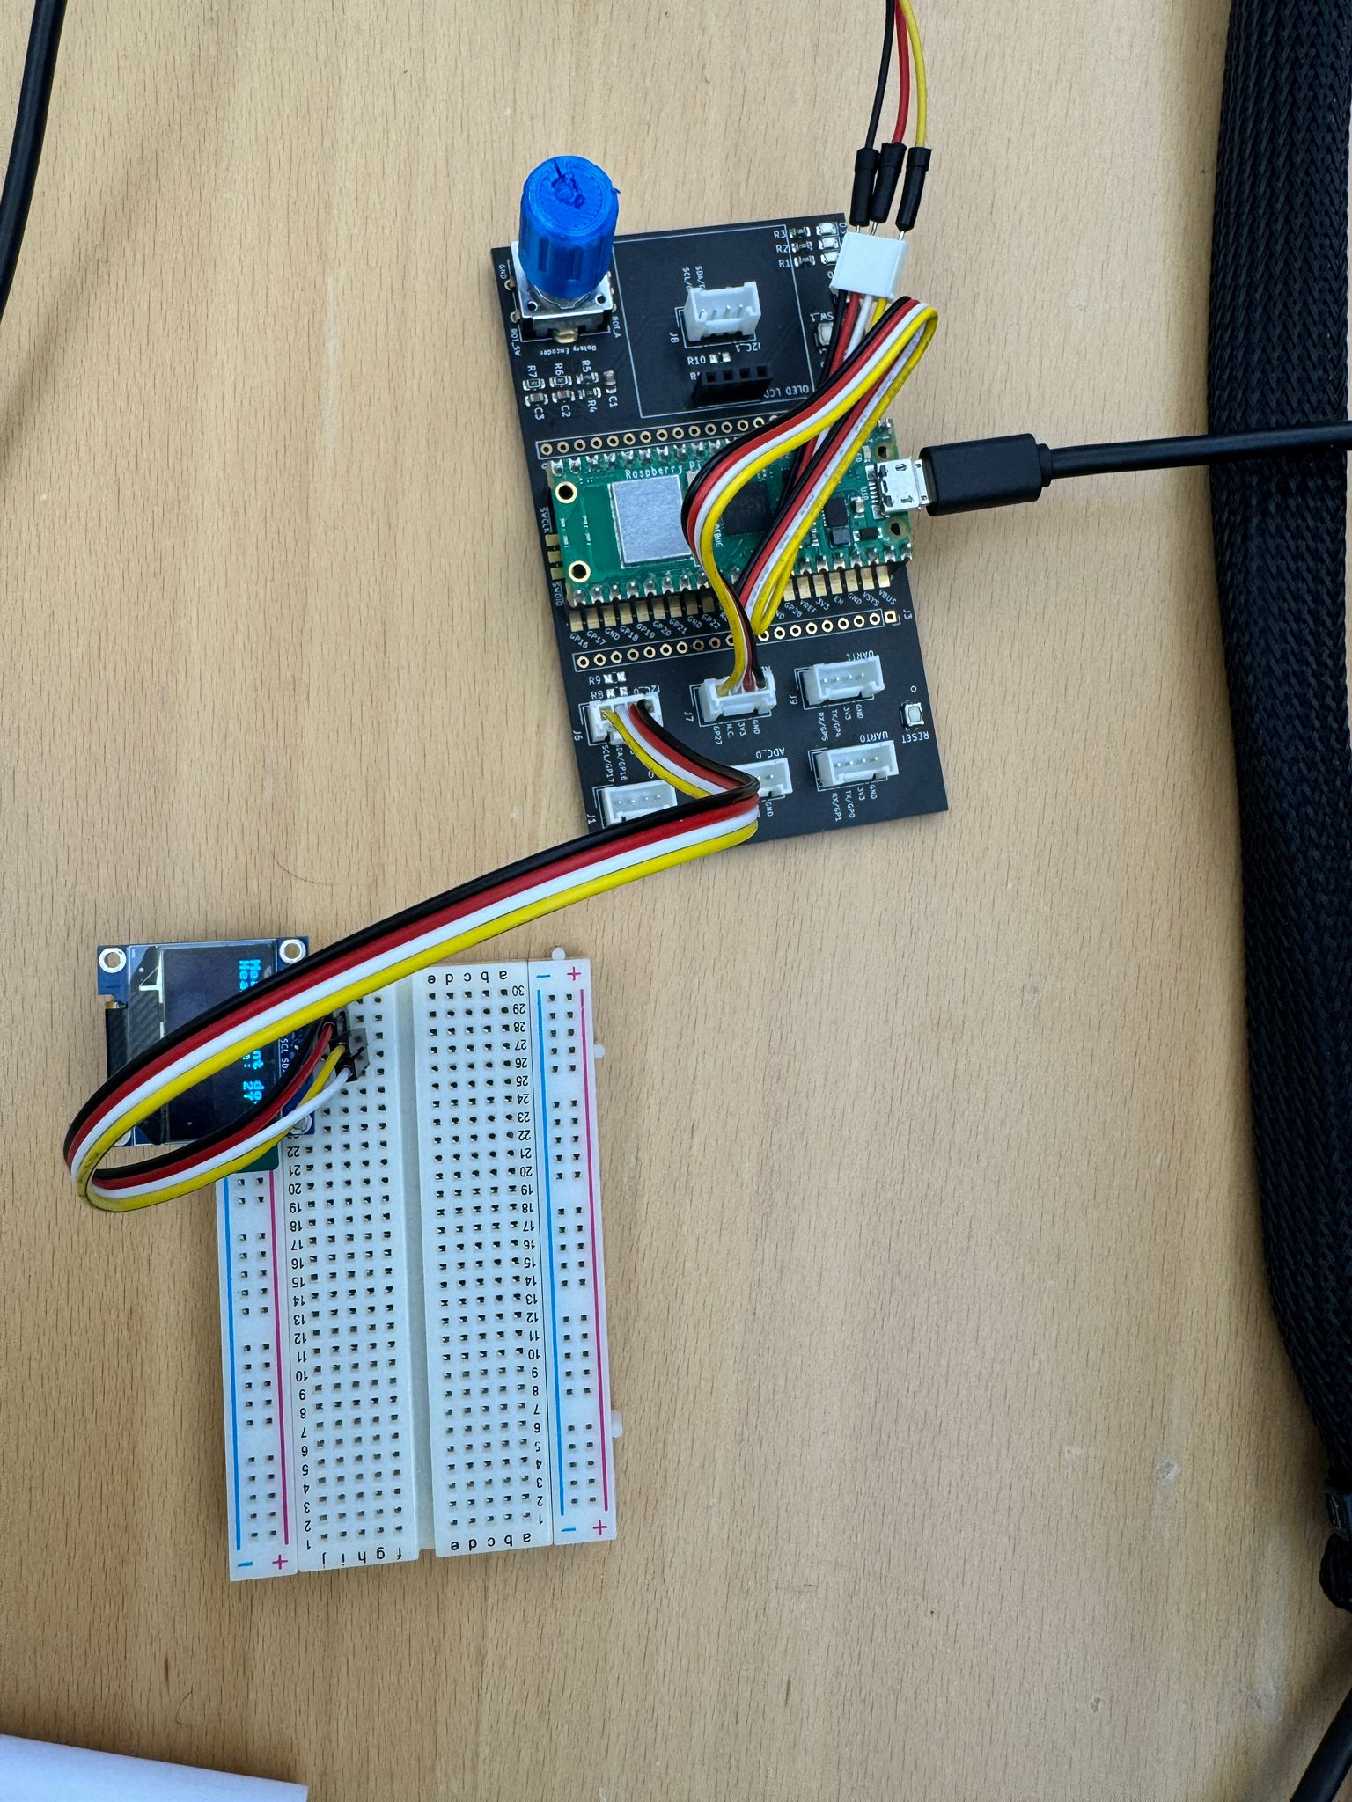
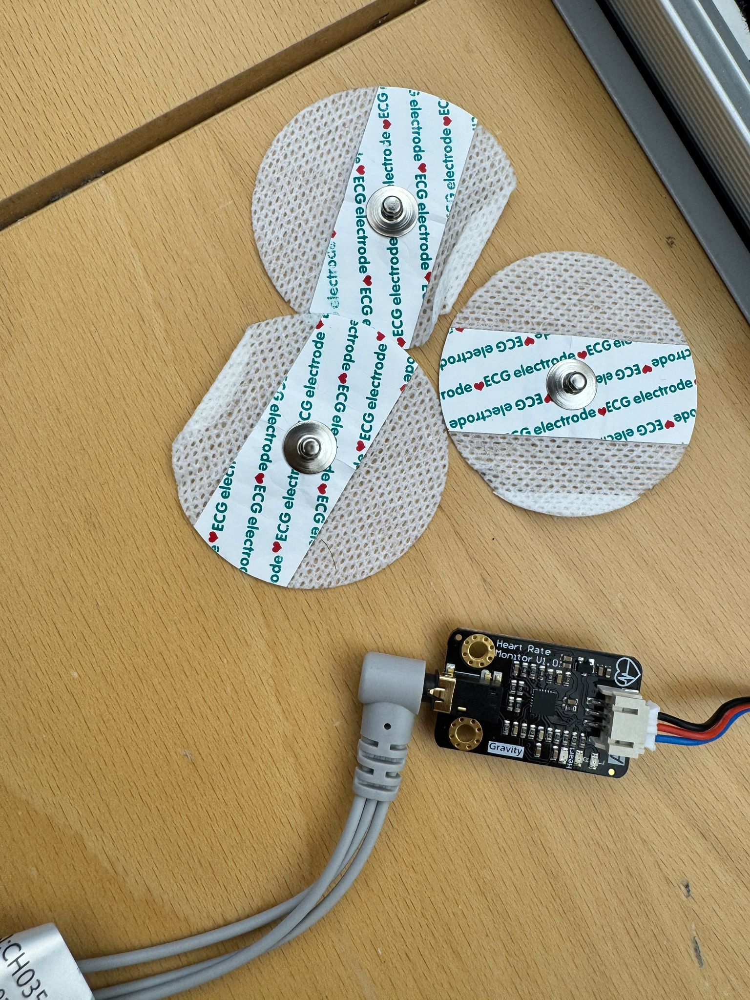
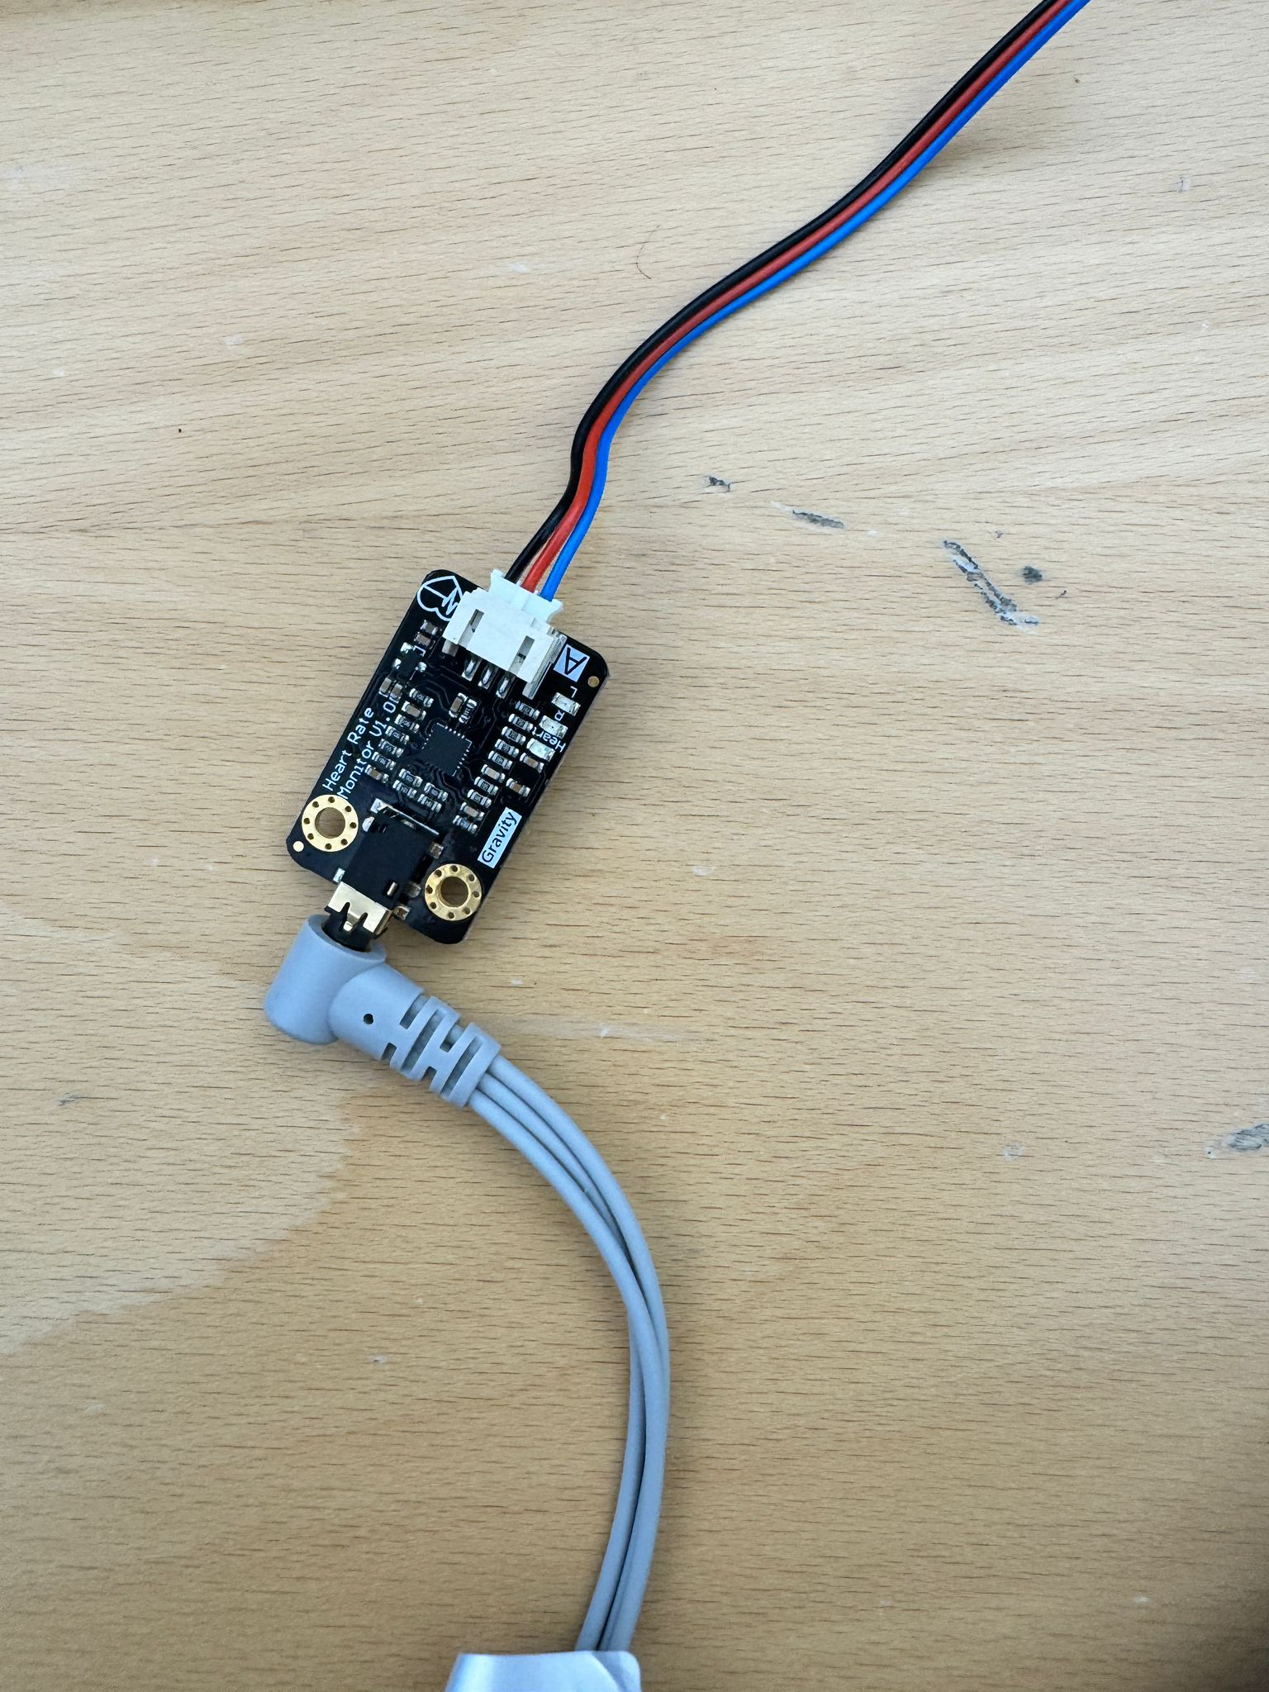

Slide 3
